Slide 1

[내부자료]
Jetson nano
2023.07.27
㈜한화하이테크
김수현

Slide 2
Cross compile
Toolchain Download (Jetson nano가아닌 Linux 에서 실행)
wget http://releases.linaro.org/components/toolchain/binaries/7.3-2018.05/aarch64-linux-gnu/gcc-linaro-7.3.1-2018.05-x86_64_aarch64-linux-gnu.tar.xz
tar xf gcc-linaro-7.3.1-2018.05-x86_64_aarch64-linux-gnu.tar.xz
tar 옵션
x : 압축파일 해지
f : 압축될 파일명 지정
vim .bashrc
export JETSON_NANO_KERNEL_SOURCE =/home/data/nano/Linux_for_Tegra/source/public
export TOOLCHAIN_PREFIX=/home/data/nano/gcc-linaro-7.3.1-2018.05-x86_64_aarch64-linux-gnu/bin/aarch64-linux-gnu-
export TEGRA_KERNEL_OUT=$JETSON_NANO_KERNEL_SOURCE/build
export KERNEL_MODULES_OUT=$JETSON_NANO_KERNEL_SOURCE/modules

Slide 3
Cross compile and kernel Compile
.config
make -C kernel/kernel-4.9/ ARCH=arm64 O=$TEGRA_KERNEL_OUT LOCALVERSION=-tegra CROSS_COMPILE=${TOOLCHAIN_PREFIX} tegra_defconfig
zImage compile
make -C kernel/kernel-4.9/ ARCH=arm64 O=$TEGRA_KERNEL_OUT LOCALVERSION=-tegra CROSS_COMPILE=${TOOLCHAIN_PREFIX} -j8 --output-sync=target zImage
modules compile
make -C kernel/kernel-4.9/ ARCH=arm64 O=$TEGRA_KERNEL_OUT LOCALVERSION=-tegra CROSS_COMPILE=${TOOLCHAIN_PREFIX} -j8 --output-sync=target modules

Slide 4
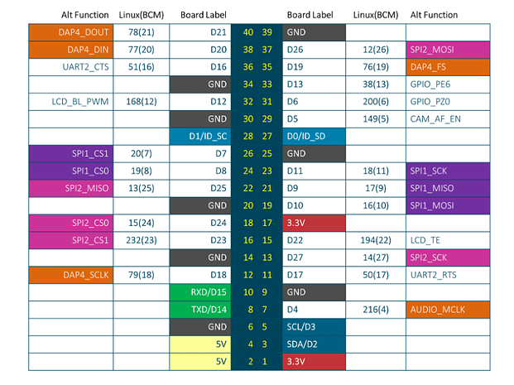
Jetson nano gpio pin number

Slide 5
sysf로 gpio 제어
echo 216 > /sys/class/gpio/export
gpio216 디렉토리 생성
gpio-tegra.c 의 printk
suhyeon : tegra_gpio_save_gpio_state(159 line)
echo out > /sys/class/gpio/gpio216/directory
출력 설정하기
gpio-tegra.c 의 printk
dmesg 출력 없음
echo 1 > /sys/class/gpio/gpio216/value
led on
cat value
gpio-tegra.c 의 printk
cat value
suhyeon : tegra_gpio_get(245 line)
echo 0 > /sys/class/gpio/gpio216/value
led off
gpio-tegra.c 의 printk
cat value
suhyeon : tegra_gpio_get(245 line)

